Slide 1
XDP Production Usage:
DDoS Protection and L4LB
Huapeng Zhou (hzhou@fb.com)
Nikita (tehnerd@fb.com)
Martin Lau (kafai@fb.com)

Slide 2




Load Balancing
Proxy (L7 LB)
Proxy (L7 LB)
… …
SHIV (L4 LB)
Proxy (L7 LB)

Slide 3
SHIV (L4 LB)
An IPVS to XDP_TX Transition

Slide 4
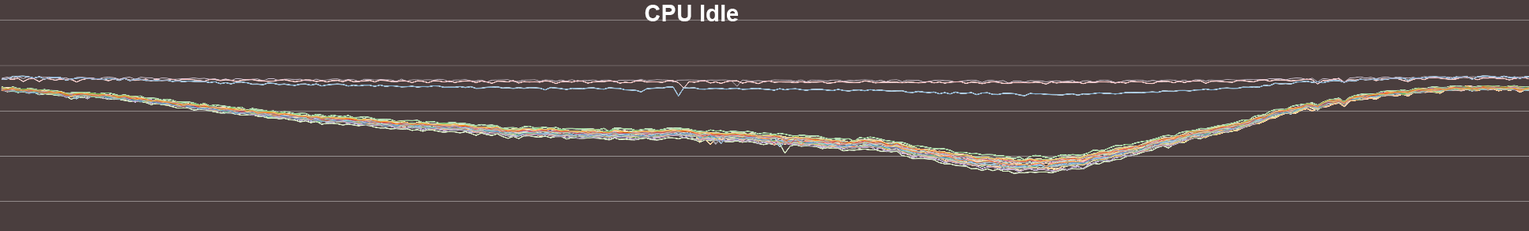
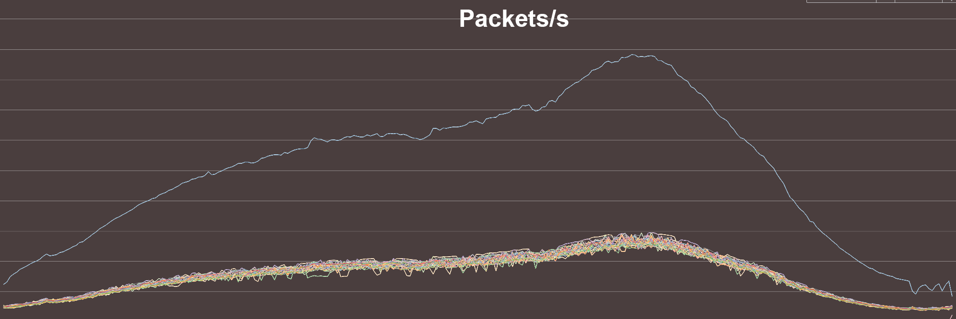
Notes:
6x improvements

Slide 5
SHIV: Map Lookups
LRU Map (/Cache)
XDP_TX
Sharding Map
(Proxy IPs)

Slide 6

XDP_TX to Proxy
bpf_xdp_adjust_head()
Client IP
VIP
sport
dport
payload… …
ETH
L4LB IP
Proxy
IP
Client IP
VIP
sport
dport
payload… …
ETH
XDP_TX

Slide 7
Droplet
Notes:
Response to that, we have developed Droplet to drop hostile packets as early and as fast as possible.

Slide 8
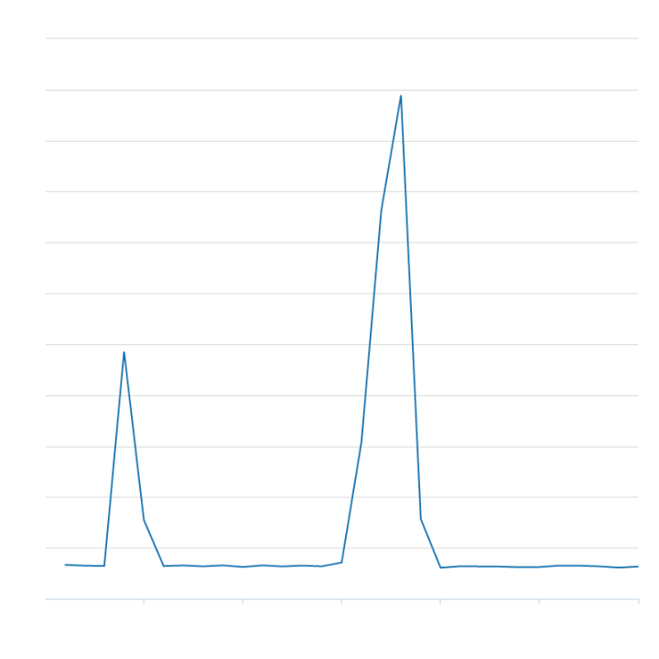
Traffic Spike at SHIV?

Slide 9
Droplet (Dreamlist):
Fast packet drop
Earliest stage in the networking stack
Programmability and Flexibility
  Easy to develop and quick to deploy (No kernel reboot)
Realized by XDP_DROP
Drop at HW limited-rate
Notes:
Let me give a quick overview of what we want for DDoS protection. In the first place, we want fast packet drop, preferably at line rate. Secondly, we’d like to drop at the earliest stage in the networking stack, to minimize unnecessary work and save CPU cycles. In addition, we want programmability, it must be easy to develop new DDoS countermeasures. And finally we want a flexible framework which could enable multiple DDoS countermeasures at the same time.

Slide 10
Droplet: DDoS Protection Framework
BPF program written in C
Loaded in kernel +
Map Setup
Run in the NIC Driver
(XDP)
Runtime compilation using bcc
Notes:
We come up with a bpf powered approach, called droplet. At a high level, DDoS mitigation techniques are implemented in C code with a restricted bpf specific syntax. The C source code is shipped as configuration files for the droplet service. We use the open source bcc library to compile the bpf programs at runtime. After they are loaded into the kernel space via bpf syscalls, we hook them into the networking stack via XDP and TC.

Slide 11
Chaining Multiple BPF_PROG
  Using bpf_tail_call + BPF_MAP_TYPE_PROG_ARRAY
XDP_TX
#0
XDP
Dump
#1
Droplet
#2
L4LB
bpf_perf_event_output()
XDP_DROP
Notes:
One limitation with XDP is that it doesn’t support chaining of multiple bpf programs. To workaround this, we use bpf_taill_call and a system wide jump program array. We have a root program attached to the interface calling into other programs. The root program could be as simple as an ordered list of bpf_tail_calls. We have predefined jump indexes for each program in the system wide jump array. For instance, in this example, DDoS occupies indexes #0 and #1 while shiv (our L4 load balancer) occupies #3. The root program will simply jump into #0 if the program is installed there. Otherwise, it will fallback to #3. If a DDoS countermeasure is installed at index #0 and we decide not to drop the packet, it will jump to the next available DDoS program, which is configured during runtime. It also uses the shiv jump index as a fallback option if no further DDoS logic is needed.

Slide 12
Questions?

Slide 13


Proxy (L7 LB)
SHIV (L4 LB)

Slide 14
Droplet: DDoS Protection Framework
Droplet: DDoS Protection Framework
Programmability: abstract away interactions with user space
Droplet handler: handles the dirty work
  Runtime compilation
  Kernel load/hook
Different types of handlers
  GenericHandler
  IPHandler
  PrefixHandler …
The user only needs to write BPF code in C
Notes:
To make it easier to come up with new DDoS countermeasures, we need to abstract away interactions of BPF code with user space. We provide abstraction via the handler concept, where all the underlying dirty work happens. For instance, runtime compilation, kernel load/hook etc. To further ease programming mitigations, we provided different types of handlers, to accompany different use cases from the user space. For example, a generic handler doesn’t require any inputs from the user space, while an IP handler requires IP address BPF maps to be populated from user space. There can be different types of handlers when more features are available in the kernel.
The end goal of this abstraction is to make sure the user only needs to write BPF code in C. The rest should magically happens.

Slide 15
Lab tests (w/ pktgen)
Under 99% cache hit: 3x to 6x improvement
Under 0% cache hit: 10x
(up to 25x w/o session tracking)

Slide 16
TCP/IP stack processing on recv
IPVS is too generic
Poor DDOS survivability
Hard to add new features

Slide 17
XDP vs IPVS

